Slide 1
SELECT statement (Part 5)
CSIT882: Data Management Systems
Notes:
<!-- Neural, Brian, Male, British English. -->
<speak>
<break time="0.5s"/>
<prosody rate="90%">
SELECT statement, part 5.
<break time="0.3s"/>
This presentation explains how to implement the nested queries.
<break time="0.5s"/>
</prosody>
</speak>
1
Systems Analysis

Slide 2
Outline
Nested queries
Correlated nested queries
2
Notes:
<!-- Neural, Brian, Male, British English. -->
<speak>
<break time="0.5s"/>
<prosody rate="90%">
Nested queries.
<break time="0.5s"/>
</prosody>
</speak>
Systems Analysis
2

Slide 3
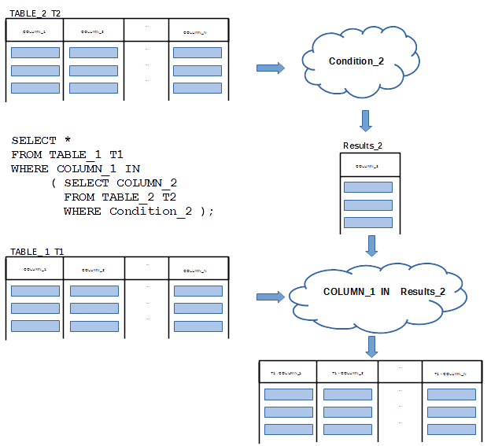
Nested queries
Nested query is a query where another query is embedded in WHERE or SELECT or FROM clauses
3
Notes:
<!-- Neural, Brian, Male, British English. -->
<speak>
<break time="0.5s"/>
<prosody rate="90%">
A nested query is a query, that has another query embedded in its WHERE or SELECT or FROM clauses.
<break time="0.3s"/>
Implementation of nested queries allows for decomposition of complex queries into a series of simple queries nested one in another.
<break time="0.3s"/>
For example, assume, that a selection condition: CONDITION 2 is applied to a relational table: TABLE 2, see a diagram in the present slide.
<break time="0.3s"/>
Projection of the results on a column: COLUMN 1, provides the values in a COLUMN 1 of relational table: TABLE 2, that satisfy CONDITION 2.
<break time="0.3s"/>
In the next step, a set of values obtained from the first SELECT statement is used in a selection condition applied to a relational table: TABLE 1.
<break time="0.3s"/>
Then, there is no need to join the relational tables: TABLE 1 and TABLE 2 to select from: TABLE 1 all rows that belongs to the results selected from a relational table: TABLE 2.
<break time="0.3s"/>
A nested SELECT statement implements a query, that "finds the rows from a relational table: TABLE 1 such that a value in a column: COLUMN 1, is included in the values from COLUMN 1 in a table: TABLE 2, in the rows that satisfy a condition: Condition 2.
<break time="0.3s"/>
A schema explaining how a nested query is constructed is given in the present slide.
<break time="0.3s"/>
Implementation of nested queries always starts from the implementation of the innermost SELECT statement.
<break time="0.3s"/>
In our case it is a query, that "finds in a relational table: TABLE 2, the rows that satisfy a condition: Condition 2.
<break time="0.3s"/>
In the next step, the results are pojected on a column: COLUMN 1 and used in the outer SELECT statement.
<break time="0.3s"/>
It is possible to consider the innner SELECT statement as a definition of inline view, that is later on used in the outer SELECT statement.
<break time="0.5s"/>
</prosody>
</speak>
Systems Analysis
3

Slide 4
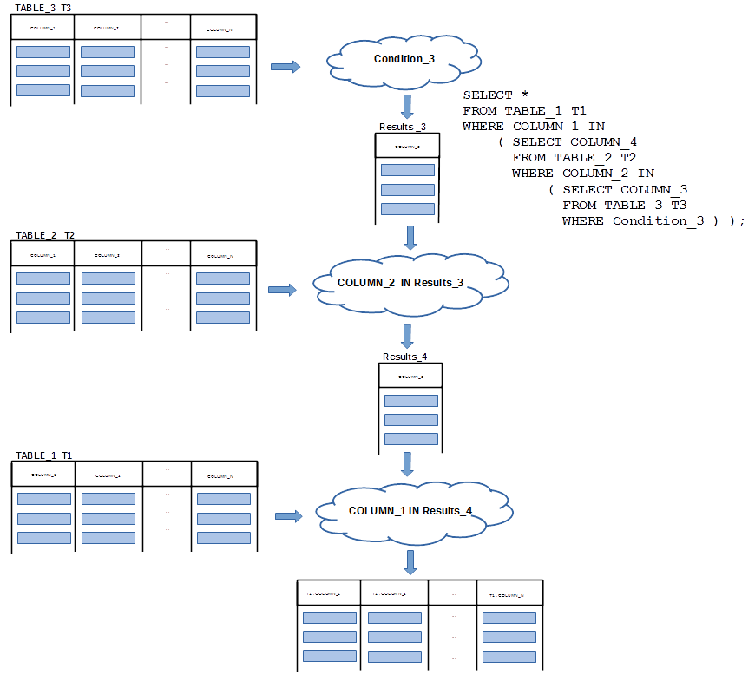
Nested queries
Nested query is a query where another query is embedded in WHERE or SELECT or FROM clauses
4
Notes:
<!-- Neural, Brian, Male, British English. --><speak><break time="0.5s"/><prosody rate="90%">
<break time="0.3s"/>
It is possible to nest SELECT statement to any level.
<break time="0.3s"/>
For example, the present slide shows how to create a nested SELECT statement with three levels of nesting.
<break time="0.3s"/>
The innermost SELECT statement selects the values from a column: COLUMN 3, from all rows in a relational table: TABLE 3, that satisfy a condition: Condition 3.
<break time="0.3s"/>
Next, the results are used in SELECT statement, that selects the values from a column: COLUMN 4, from all rows in a relational table: TABLE 2, that satisfy a condition: COLUMN 2 IN the results of the previous SELECT statement.
<break time="0.3s"/>
Finally, the results from the second level of nesting are used in SELECT statement, that select the entire rows from a relational table: TABLE 1, that satisfy a condition: COLUMN 1 IN the results of SELECT statement at the second level of nestings.
<break time="0.3s"/>
A schema explaining how a nested query is constructed is given in the present slide.
<break time="0.5s"/>
</prosody>
</speak>
Systems Analysis
4

Slide 5
Nested queries
Sample database
CREATE TABLE DEPARTMENT(
name VARCHAR(50) NOT NULL,
code CHAR(5) NOT NULL,
total_staff_number DECIMAL(2) NOT NULL,
chair VARCHAR(50) NULL,
budget DECIMAL(9,1) NOT NULL,
CONSTRAINT dept_pkey PRIMARY KEY(name),
CONSTRAINT dept_ckey1 UNIQUE(code),
CONSTRAINT dept_ckey2 UNIQUE(chair),
CONSTRAINT dept_check1 CHECK (total_staff_number BETWEEN 1 AND 50) );
CREATE TABLE COURSE(
cnum CHAR(7) NOT NULL,
title VARCHAR(200) NOT NULL,
credits DECIMAL(2) NOT NULL,
offered_by VARCHAR(50) NULL,
CONSTRAINT course_pkey PRIMARY KEY(cnum),
CONSTRAINT course_check1 CHECK (credits IN (6, 12)),
CONSTRAINT course_fkey1 FOREIGN KEY(offered_by)
REFERENCES DEPARTMENT(name) ON DELETE CASCADE );
5
Notes:
<!-- Neural, Brian, Male, British English. --><speak><break time="0.5s"/><prosody rate="90%"><break time="0.3s"/>In this presentation, we again use the same sample database, that contains information about the departments and about the courses offered by the departments.<break time="0.3s"/>Information about the departments is kept in a relational table: DEPARTMENT.<break time="0.3s"/>A description of a department consists of: a department name, department code, total staff number and budget.<break time="0.3s"/>A name of a department uniquelly identifies each department.<break time="0.3s"/>A code of a department also uniquelly identifies each department.<break time="0.3s"/>Total staff number per department cannot be greater than 50.<break time="0.3s"/>A description of a course consists of: a course number, title, credits and name of department that offers a course.<break time="0.3s"/>A course number is a unique identifier of each course.<break time="0.3s"/>The granted credits can be equal to either 6 or 12.<break time="0.5s"/></prosody></speak>
Systems Analysis
5

Slide 6
Nested queries
A class of nested queries is based on a concept of inline views
Inline views can be used to reduce the complexity of query implementation
An inner query is created first and its outcomes are used as a temporary relational table (inline view) in an outer query
For example, a query “find the titles of courses offered by a department chaired by Peter” can be decomposed into the following two subqueries:
Q1: Find a department chaired by Peter
Q2: Find the titles of courses offered by a department found in Q1
A subquery Q1 is implemented first and then it is used in WHERE clause of subquery Q2
6
Notes:
<!-- Neural, Brian, Male, British English. -->
<speak>
<break time="0.5s"/>
<prosody rate="90%">
A class of nested queries is based on a concept of inline views.
<break time="0.3s"/>
Inline views can be used to reduce the complexity of implementation of large SELECT statements.
<break time="0.3s"/>
An inner query is created first and its outcomes are used as a temporary relational table (inline view) in an outer query.
<break time="0.3s"/>
For example, a query "find the titles of courses offered by a department chaired by Peter" can be decomposed into the following two sub queries.
<break time="0.3s"/>
A subquery Q 1: "Find a department chaired by Peter".
<break time="0.3s"/>
A subquery Q 2: Find the titles of courses offered by a department found in a subquery Q 1.
<break time="0.3s"/>
A subquery Q 1 is implemented first and then it is used in WHERE clause of subquery Q 2.
<break time="0.5s"/>
</prosody>
</speak>
Systems Analysis
6

Slide 7
Nested queries
It is possible to nest SELECT statements to theoretically unlimited level in WHERE clauses
SELECT title
FROM COURSE
WHERE offered_by = ( SELECT name
FROM DEPARTMENT
WHERE chair = 'Peter’ );
If an inner query returns more than one row then it is important to use IN instead of = sign
Using = sign allows for more efficient implementation of a nested query in a situation where an inner query always return at most one row
7
Notes:
<!-- Neural, Brian, Male, British English. -->
<speak>
<break time="0.5s"/>
<prosody rate="90%">
It is possible to nest SELECT statements to theoretically unlimited level in WHERE clause.
<break time="0.3s"/>
A sample nested query in the middle of the present slide implements a query "find the titles of courses offered by a department chaired by Peter".
<break time="0.3s"/>
Interpretation of the nested query given in the present slide is the following.
<break time="0.3s"/>
First, the inner query retrieves from a relational table: DEPARTMENT, the names of departments chaired by Peter.
<break time="0.3s"/>
Note, that there may be at most one department chaired by Peter because a column: name, is a candidate key in a relational table: DEPARTMENT.
<break time="0.3s"/>
Next, the result from processing of inner query is used in a condition: "offered by equals to a name of department found by an inner query", to select the rows for a relational table: COURSE.
<break time="0.3s"/>
Finally, the titles of courses offered by a department chaired by Peter are returned, as the final results of the query processing.
<break time="0.3s"/>
It is important to remember, that if an inner query returns more than one row, then we must use set membership symbol: IN, instead of: equals sign.
<break time="0.3s"/>
If an inner query returns at most one row we still must use equals sign.
<break time="0.3s"/>
Using equals sign allows for more efficient implementation of a nested query, in a situation where an inner query always returns at most one row.
<break time="0.5s"/>
</prosody>
</speak>
Systems Analysis
7

Slide 8
Nested queries
A way how we implement a query find the titles of courses offered by a department chaired by Peter is the following
Create a inner query as inline view Q
( SELECT name
FROM DEPARTMENT
WHERE chair = 'Peter' ) Q
Create outer query that references an inline view Q created earlier
SELECT title
FROM COURSE
WHERE offered_by = Q.name
Replace a reference Q to an inline view with the inline view
SELECT title
FROM COURSE
WHERE offered_by = ( SELECT name
FROM DEPARTMENT
WHERE chair = 'Peter' )
8
Notes:
<!-- Neural, Brian, Male, British English. -->
<speak>
<break time="0.5s"/>
<prosody rate="90%">
A query: "find the titles of courses offered by a department chaired by Peter" is implemented in the following way.
<break time="0.3s"/>
We start from the implementation of an inner query that finds: a name of department chaired by Peter, as an inline view Q.
<break time="0.3s"/>
Implementation of an inline view Q is given at the top of the present slide.
<break time="0.3s"/>
Next, we implement an outer query, that finds the titles of courses offered by a department, whose name has been retrieved by an inner query implemented as an inline view Q.
<break time="0.3s"/>
Implementation of the second step, is given in the middle of the present slide.
<break time="0.3s"/>
Of course, a notation: "offered by equals Q dot name" is used only to denote a fact, that in the next step a definition of inline view: Q, must be copied into an outer query.
<break time="0.3s"/>
The final implementation of the nested query, that "find the titles of courses offered by a department chaired by Peter", is given at the bottom of the present slide.
<break time="0.5s"/>
</prosody>
</speak>
Systems Analysis
8

Slide 9
Nested queries
In another example we implement a query “find the chair people of all departments that offer 12 credit point courses” as a nested query
Implementation starts from a subquery that finds the names of departments that offer at least one 12 credit point course
( SELECT offered_by
FROM COURSE
WHERE credits = 12) Q;
Create outer query that references an inline view Q created earlier
SELECT chair
FROM DEPARTMENT
WHERE name IN Q.offered_by
Replace a reference to an inline view Q with the inline view itself
SELECT chair
FROM DEPARTMENT
WHERE name IN ( SELECT offered_by
FROM COURSE
WHERE credits = 12 );
9
Notes:
<!-- Neural, Brian, Male, British English. -->
<speak>
<break time="0.5s"/>
<prosody rate="90%">
In another example, we implement a nested query, that “finds the chair people of all departments that offer 12 credit point courses".
<break time="0.3s"/>
We start from a subquery, that "finds the names of departments that offer at least one 12 credit point course".
<break time="0.3s"/>
SELECT statement, that implements the first subquery is given at the top of the present slide.
<break time="0.3s"/>
In the next step we create an outer subquery, that "finds the chair people of departmens found in the inner subquery".
<break time="0.3s"/>
A preliminary implementation of an outer subquery is given in the middle of the present slide.
<break time="0.3s"/>
Of course, a notation: "name in Q dot offered by", does not compile well and we have to replace a name of inline view: Q, with a definition of inline view created in the first step.
<break time="0.3s"/>
The final implementation of a nested query, that finds “finds the chair peoples of all departments that offer 12 credit point courses”, is given at the bottom of the present slide.
<break time="0.5s"/>
</prosody>
</speak>
Systems Analysis
9

Slide 10
Nested queries
A query find the chairs of all departments that offer no courses requires implementation of ANTIJOIN operation
It is equivalent to a query that finds all rows in a relational table DEPARTMENT that cannot be joined with any row in a relational table COURSE
An inner query implemented as inline view finds all departments that offer at least one course
( SELECT offered_by
FROM COURSE ) Q;
An outer query finds all chairs of departments that are NOT included in the results of an inner query
SELECT chair
FROM DEPARTMENT
WHERE name NOT IN Q.offered_by
10
Notes:
<!-- Neural, Brian, Male, British English. -->
<speak>
<break time="0.5s"/>
<prosody rate="90%">
A query: find the chairs of all departments that offer no courses", requires implementation of the ANTIJOIN operation.
<break time="0.3s"/>
The ANTIJOIN operation returns all rows from the first argument of the operation, that cannot be joined with any row from the second argument of the operation.
<break time="0.3s"/>
In contrast, the JOIN operation returns all rows joined from the first and the second argument of the operation.
<break time="0.3s"/>
In the other words, all rows from the first and the second argument that can be joined.
<break time="0.3s"/>
The SEMIJOIN operation is the opposite to the ANTIJOIN operation and it returnes all rows from the first argument of the operation, that can be joined with at least one row from the second argument of the operation.
<break time="0.3s"/>
Both ANTIJOIN and SEMIJOIN operations are not directly implemented in S Q L.
<break time="0.3s"/>
The SEMIJOIN operation can be expressed in two different ways.
<break time="0.3s"/>
The first one, is a simple JOIN operation and later on projection on the attributes of the first argumentof JOIN operation.
<break time="0.3s"/>
The second method uses a nested query with: IN condition, in WHERE clause of an outer SELECT statement.
<break time="0.3s"/>
The ANTIJOIN operation can be expressed through: LEFT or RIGHT OUTER JOIN operation, and: IS NULL condition, over the columns from either right or left argument of the operation.
<break time="0.3s"/>
The ANTIJOIN operation can also be implemented as a nested query with: NOT IN condition, in outer SELECT statement.
<break time="0.3s"/>
A query: "find the chairs of all departments that offer no courses" is equivalent to a query, that finds all rows in a relational table: DEPARTMENT, that cannot be joined with any row in a relational table: COURSE.
<break time="0.3s"/>
It is why we have to implement it, as the ANTIJOIN operation.
<break time="0.3s"/>
An inner query implemented as an inline view: Q, finds all departments, that offer at least one course.
<break time="0.3s"/>
Implementation of an inline view: Q, is given in the middle of the present slide.
<break time="0.3s"/>
An outer query, finds all chairs of departments, that are NOT included in the results of an inner query.
<break time="0.3s"/>
A temporary implementation of an outer query is given at the bottom of the present slide.
<break time="0.3s"/>
Note, that a reference to an inline view: "name not in Q dot offered by", is not syntactically correct and it is included only to show a location where an an inline view: Q, must be embedded into the final implementation.
<break time="0.5s"/>
</prosody>
</speak>
Systems Analysis
10

Slide 11
Nested queries
Finally, we replace a reference to an inline view Q with a definition of the inline view itself
SELECT chair
FROM DEPARTMENT
WHERE name NOT IN ( SELECT offered_by
FROM COURSE );
11
Notes:
<!-- Neural, Brian, Male, British English. -->
<speak>
<break time="0.5s"/>
<prosody rate="90%">
Finally, we replace a reference to an inline view: Q, with a definition of an inline view itself.
<break time="0.3s"/>
The final implementation is given at the top of the present slide.
<break time="0.3s"/>
Please note, a condition: NOT IN, in WHERE clause of an outer SELECT statement.
<break time="0.3s"/>
A nested query with: NOT IN condition, in WHERE clause is used to implement the ANTIJOIN operation.
<break time="0.5s"/>
</prosody>
</speak>
Systems Analysis
11

Slide 12
Outline
Nested queries
Correlated nested queries
12
Notes:
<!-- Neural, Brian, Male, British English. -->
<speak>
<break time="0.5s"/>
<prosody rate="90%">
Correlated nested queries.
<break time="0.5s"/>
</prosody>
</speak>
Systems Analysis
12

Slide 13
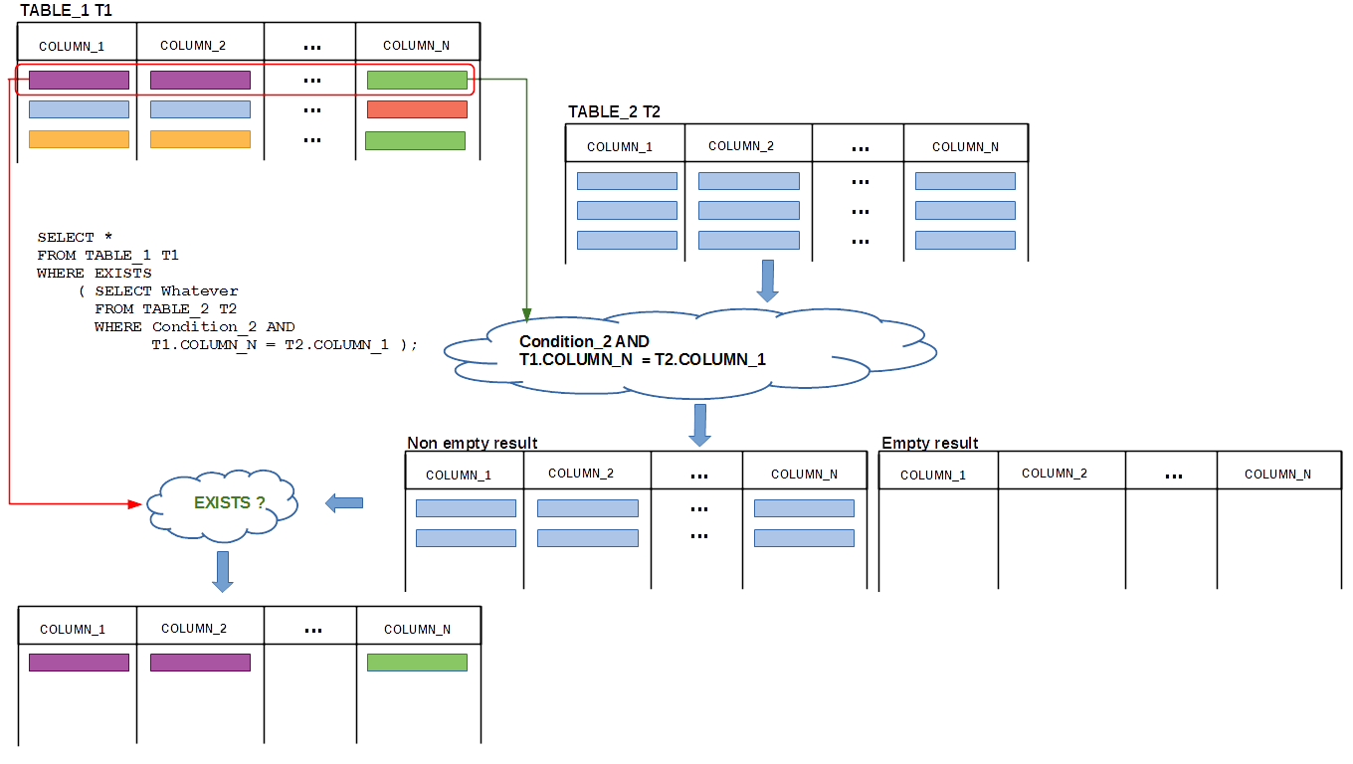
Correlated nested queries
In a correlated nested query an inline view implementing inner query references the names of relational tables used in outer query
13
Notes:
<!-- Neural, Brian, Male, British English. -->
<speak>
<break time="0.5s"/>
<prosody rate="90%">
A difference between a nested query and a correlated nested query is such, that in a correlated nested query an inline view implementing an inner query, references the names of relational tables used in an outer query.
<break time="0.3s"/>
An interpretation of a correlated nested query is the following.
<break time="0.3s"/>
The rows from a relational table accessed by an outer query are read one by one.
<break time="0.3s"/>
When a row is picked from the table then, all references located in an inner query, to the columns of the relational table used in outer query are replaced with the values of the picked row.
<break time="0.3s"/>
Next, an inner query is processed and the results are verified against either empty or not empty condition included in WHERE clause.
<break time="0.3s"/>
If a condition in WHERE clause evaluates to true, then the row from a relational table used in the outer query is saved in the results.
<break time="0.3s"/>
Otherwise the row is ignored.
<break time="0.3s"/>
The same cycle is repeated for the next row picked from a relational table used in an outer query.
<break time="0.3s"/>
A schema of interpretation of correlated nested query is presented in the current slide.
<break time="0.3s"/>
The rows from a relational table: TABLE 1, alias T 1, are read one by one and an inner query is processed for each row read.
<break time="0.3s"/>
All references in an inner query to the columns of a relational table: T 1 dot COLUMN N are replaced with the values taken from the current row.
<break time="0.3s"/>
Next, an inner query is processed and its results are tested against: EXISTS condition.
<break time="0.3s"/>
This is because: EXISTS keyword, is used in WHERE condition of an outer SELECT statement.
<break time="0.3s"/>
If the results from the processing of an inner SELECT statement are not empty, then EXISTS condition evaluates to true and a row from a relational table: T 1 is appended to the final results.
<break time="0.3s"/>
Then, the next row is picked from a relational table: T 1, the references located in an inner SELECT statement to the columns of a relational table T 1 are replaced with the values taken from the current row and an inner SELECT statement is processed again.
<break time="0.3s"/>
If the results are not empty, then the current row from a relational table: T 1, is appended to the final results.
<break time="0.3s"/>
Please note, that it really does not matter what values are retrieved by an inner query.
<break time="0.3s"/>
It is important whether the results of inner query are not empty, if EXIST is used in WHERE clause or empty, if NOT EXISTS is used in WHERE clause.
<break time="0.3s"/>
This is why, it is possible to SELECT whatever, for example a constant: x, in an inner SELECT statement of a correlated nested query.
<break time="0.5s"/>
</prosody>
</speak>
Systems Analysis
13

Slide 14
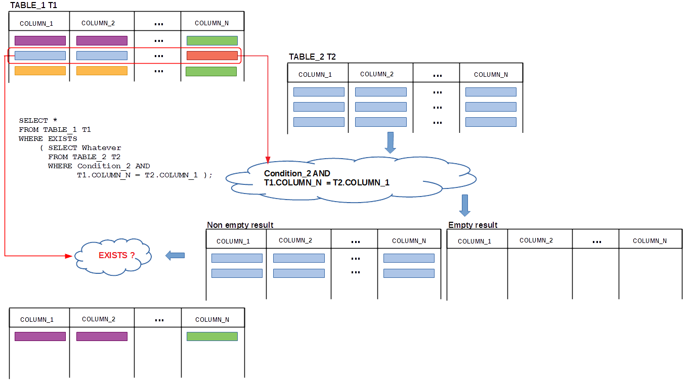
Correlated nested queries
In a correlated nested query an inline view implementing inner query references the names of relational tables used in outer query
14
Notes:
<!-- Neural, Brian, Male, British English. -->
<speak>
<break time="0.5s"/>
<prosody rate="90%">
In an interpretation visualised in the present slide, the second row from a relational table: T 1, is used to replace the references to the columns in a relational table T 1 in an inner SELECT statement, with values taken from the row.
<break time="0.3s"/>
Then, an inner SELECT statement is processed and because the results of its processing are empty, the second row from a relational table: T 1, is not include into the final results.
<break time="0.3s"/>
Note, that if an inner SELECT statement does not have any references to a relational table used in an outer SELECT statement, then either nothing or all rows from a relational table used in an outer query, are included into the final result.
<break time="0.3s"/>
It is so because, evaluation: of EXISTS or NOT EXISTS condition, does not depend on the rows picked from a relational table used in an outer SELECT statement.
<break time="0.3s"/>
A correlated nested query must have in an inner query the references to the values selected in an outer query.
<break time="0.5s"/>
</prosody>
</speak>
Systems Analysis
14

Slide 15
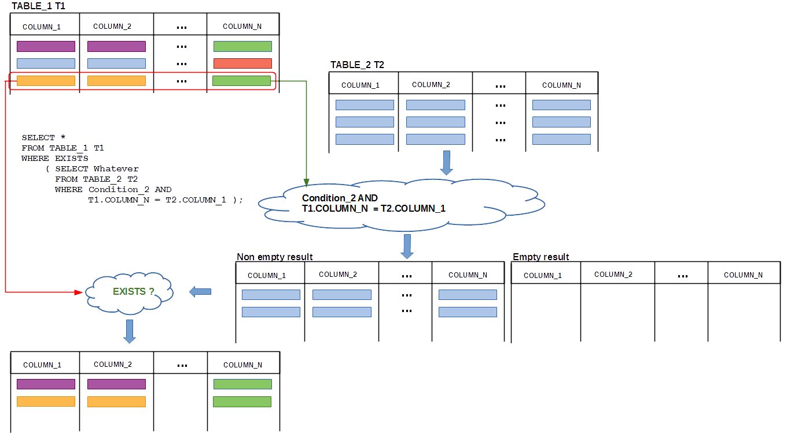
Correlated nested queries
In a correlated nested query an inline view implementing inner query references the names of relational tables used in outer query
15
Notes:
<!-- Neural, Brian, Male, British English. -->
<speak>
<break time="0.5s"/>
<prosody rate="90%">
In an interpretation visualised in the present slide, the third row from relational table: T 1, is used to replace the references to the columns in a relational table: T 1, in an inner SELECT statement with the values.
<break time="0.3s"/>
Then, an inner SELECT statement is processed and because the results of its processing are not empty the second row from a relational table: T 1, is included into the final results.
<break time="0.5s"/>
</prosody>
</speak>
Systems Analysis
15

Slide 16
Correlated nested queries
For example, consider a query: Find the chairs of departments, that offer 12 credit point courses
Such query can be re-phrased as an equivalent query find the chairs of departments, such that there exists at least one course worth 12 credit points offered by a department we are looking for
An inner query ... course worth 12 credit points offered by a department we are looking for is implemented as the following inline view
( SELECT *
FROM COURSE
WHERE credits = 12 AND offered_by = DEPARTMENT.name ) Q
An outer query find the chairs of departments, such that there exists at least one course found in the inner query is implemented in the folowing way
SELECT chair
FROM DEPARTMENT
WHERE EXISTS Q
16
Notes:
<!-- Neural, Brian, Male, British English. -->
<speak>
<break time="0.5s"/>
<prosody rate="90%">
Implementation of a correlated nested query, usually needs a transformation of a natural language specification of a query, into a form that uses "exists" or "not exists" quantifiers.
<break time="0.3s"/>
For example, a query like: "find the chairs of departments, that offer 12 credit point courses", should be re-phrased into a query: "find the chairs of departments, such that there exists at least one course worth 12 credits and it is offered by a department we are looking for".
<break time="0.3s"/>
Such specification of a query sounds a bit awkward, but a phrase: "there exists at least one ..." makes the specification almost the same as SELECT statement.
<break time="0.3s"/>
Then, an inner query " ... course worth 12 credit points offered by a department we are looking for" is implemented as an inline view: Q, given in the middle of the present slide.
<break time="0.3s"/>
An inline view: Q, contains a reference to a department name: DEPARTMENT dot name, that implements a reference "... offered by a department we are looking for".
<break time="0.3s"/>
Next, we implement an outer query, that "finds the chairs of departments that there exists at least one course in a view: Q."
<break time="0.3s"/>
SELECT statement, that implements such query is given at the bottom of the present slide.
<break time="0.3s"/>
SELECT statement has EXISTS quantifier, in WHERE clause and at the moment uses a name of an inline view: Q,
<break time="0.3s"/>
Of course, to make the query syntactically correct, we have to replace a name of an inline view: Q, with a definition of the view.
<break time="0.5s"/>
</prosody>
</speak>
Systems Analysis
16

Slide 17
Correlated nested queries
Finally, we replace a reference Q to an inline view with the inline view itself
SELECT chair
FROM DEPARTMENT
WHERE EXISTS ( SELECT *
FROM COURSE
WHERE credits = 12 AND
offered_by = DEPARTMENT.name )
17
Notes:
<!-- Neural, Brian, Male, British English. -->
<speak>
<break time="0.5s"/>
<prosody rate="90%">
A complete implementation of the query is given in the present slide.
<break time="0.3s"/>
Interpretation of such query is performed in the following way.
<break time="0.3s"/>
The first row is picked from a relational table: DEPARTMENT.
<break time="0.3s"/>
A value of an attribute: name, taken from the row replaces a reference:"DEPARTMENT dot name", in WHERE condition of an inner SELECT statement.
<break time="0.3s"/>
An inner SELECT statement is processed and the result of processing is either empty or not empty.
<break time="0.3s"/>
If the result of processing is not empty, then it means, that there exists a course worth 12 credits an offered by a department with a name included in the first row in a relational table: DEPARTMENT.
<break time="0.3s"/>
It means, that the first row satisfies a search condition and a value of an attribute: chair, in the row can be inserted into the final results of query processing.
<break time="0.3s"/>
Next, the second row is picked from a relational table: DEPARTMENT.
<break time="0.3s"/>
Again, a value of attribute: name, taken from the row replaces a reference: "DEPARTMENT dot name", in WHERE condition of an inner SELECT statement and
an inner SELECT statement is processed.
<break time="0.3s"/>
If the results of processing are empty, then a value of an attribute: chair, in the second row is not included into the final results of the query.
<break time="0.3s"/>
If the results of processing of an inner query are not empty then a value of an attribute: chair, is inserted into the final results of query processing.
<break time="0.3s"/>
Next, the third row is taken from a relational table: DEPARTMENT and a value of attribute: name, in the row, replaces a reference: "DEPARTMENT dot name", in WHERE condition of an inner SELECT statement and an inner SELECT statement is processed.
<break time="0.3s"/>
If the results of processing are not empty, then a value of an attribute chair in the third row is included into the final results of the query, otherwise the third row is skipped.
<break time="0.3s"/>
And the same procedure is repeated for all remaining rows in a relational table: DEPARTMENT.
<break time="0.5s"/>
</prosody>
</speak>
Systems Analysis
17

Slide 18
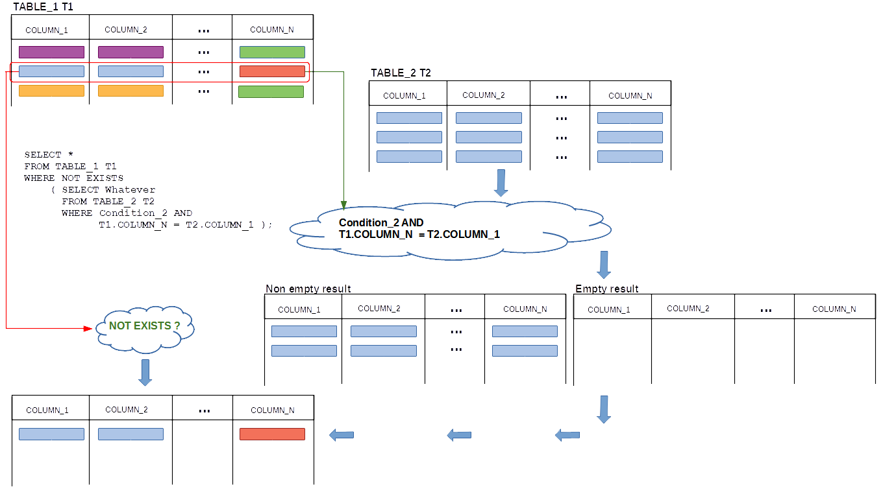
Correlated nested queries
In a correlated nested query an inline view implementing inner query references the names of relational tables used in outer query
18
Notes:
<!-- Neural, Brian, Male, British English. -->
<speak>
<break time="0.5s"/>
<prosody rate="90%">
In an interpretation visualised in the present slide, the second row from a relational table: T 1, is used to replace the references to the columns in a relational table: T 1, in an inner SELECT statement with the values taken from the row.
<break time="0.3s"/>
Then, an inner SELECT statement is processed and because the results of its processing are empty, the second row from a relational table: T 1, is included into the final results.
<break time="0.3s"/>
It is so because, evaluation of NOT EXISTS condition, returns true, if no rows are retrieved by the inner SELECT statement.
<break time="0.5s"/>
</prosody>
</speak>
Systems Analysis
18

Slide 19
Correlated nested queries
Another example where inline view references a name of relational table used in outer SELECT statement is the following: ”find the chairs of all departments that offer no courses”
It is equivalent to a query find the chairs of departments such that does not exist a course offered by a department we are looking for
An inner query finds ... a course offered by a department we are looking for
( SELECT *
FROM COURSE
WHERE offered_by = DEPARTMENT.name ) Q;
An outer query finds all chairs of departments such that does not exist a course found by an inner query
SELECT chair
FROM DEPARTMENT
WHERE NOT EXISTS Q
19
Notes:
<!-- Neural, Brian, Male, British English. -->
<speak>
<break time="0.5s"/>
<prosody rate="90%">
In the next example, we use a technique of correlated nested queries to implement a query: "find the chairs of all departments that offer no courses”
<break time="0.3s"/>
The query can be rewritten into a format with: "not exists" phrase, in the following way.
<break time="0.3s"/>
"Find the chairs of departments, such that does not exist a course offered by a department we are looking for."
<break time="0.3s"/>
We start from implementation of an inline view: Q, that includes a query: "finds all courses offered by a department we are looking for".
<break time="0.3s"/>
Implementation of an inline view is given in the middle of the present slide.
<break time="0.3s"/>
In the next step, we implement a query, that "finds all chairs of departments such that does not exist a course included in the inline view".
<break time="0.3s"/>
Implementation of a query with a reference to inline view: Q, is given at the bottom of the present slide.
<break time="0.3s"/>
Finally, to get a syntactically correct statement, we replace a name of inline view: Q, with a definition of the view, see the next slide.
<break time="0.5s"/>
</prosody>
</speak>
Systems Analysis
19

Slide 20
Correlated nested queries
Finally, we replace a reference Q to an inline view with the inline view itself
SELECT chair
FROM DEPARTMENT
WHERE NOT EXISTS( SELECT *
FROM COURSE
WHERE offered_by = DEPARTMENT.name );
20
Notes:
<!-- Neural, Brian, Male, British English. -->
<speak>
<break time="0.5s"/>
<prosody rate="90%">
A complete implementation of the query is given in the present slide.
<break time="0.3s"/>
Interpretation of such query is performed in the following way.
<break time="0.3s"/>
The first row is taken from a relational table: DEPARTMENT.
<break time="0.3s"/>
A value of an attribute: name, in the row replaces a refrence: "DEPARTMENT dot name", in WHERE condition of an inner SELECT statement.
<break time="0.3s"/>
An inner SELECT statement is processed and the result of processing is either empty or not empty.
<break time="0.3s"/>
If the result of processing is empty, then it means that does not exist a course offered by a department with a name included in the first row in a relational table: DEPARTMENT.
<break time="0.3s"/>
It means, that the first row satisfies a search condition and a value of an attribute: chair, can be inserted into the final results of query processing.
<break time="0.3s"/>
Next, the second row is taken from a relational table: DEPARTMENT.
<break time="0.3s"/>
Again, a value of attribute: name, in the row, replaces a reference: DEPARTMENT dot name, in WHERE condition of an inner SELECT statement and
an inner SELECT statement is processed.
<break time="0.3s"/>
If the results of processing are not empty, then a value of an attribute: chair, in the second row is not included into the final results of the query.
<break time="0.3s"/>
If the results of processing of an inner query are empty, then then a value of an attribute: chair, is inserted into the final results of query processing.
<break time="0.3s"/>
Next the third row is taken from a relational table: DEPARTMENT, and a value of attribute: name, in the row replaces a refrence: DEPARTMENT dot name, in WHERE condition of an inner SELECT statement and an inner SELECT statement is processed.
<break time="0.3s"/>
If the results of processing are empty, then a value of an attribute: chair, in the third row is included into the final results of the query, otherwise the third row is skipped.
<break time="0.3s"/>
And the same procedure is repeated for all remaining rows in a relational table: DEPARTMENT
<break time="0.5s"/>
</prosody>
</speak>
Systems Analysis
20

Slide 21
References
C. Coronel, S. Morris, A. Basta, M. Zgola, Data Management and Security, Chapters 5, 7, Cengage Compose eBook, 2018, eBook: Data Management and Security, 1st Edition
T. Connoly, C. Begg, Database Systems, A Practical Approach to Design, Implementation, and Management, Chapters 6.3.7 Multi-table Queries, Pearson Education Ltd, 2015
D. Darmawikarta, SQL for MySQL A Beginner’s Tutorial, Chapter 6, pages 62 - 63 Brainy Software Inc. First Edition: June 2014
How to ... ? Cookbook, How to implement queries in SQL ? (Part 2) Recipe 6.2 How to implement outer joins ?
21
Notes:
<!-- Neural, Brian, Male, British English. -->
<speak>
<break time="0.5s"/>
<prosody rate="90%">
References.
<break time="0.5s"/>
</prosody>
</speak>
Systems Analysis
21

